Slide 1
Visualizing the Loss Landscape of Neural Nets
Team Members:
Meer Suri, Chandni Akbar, Siffi Singh, Joseph la Chataigne,
Raphaël Boulanger, Pierric Meunier

Slide 2
Outline
Introduction and Motivation
Loss Function Visualization Technique
Effect of Regularization on loss landscape
Effect of depth on the loss landscape
Effect of skip connections on the loss landscape
Visualization of the Optimization trajectory
Effect of Batch size on the loss landscape
Conclusion and References

Slide 3
Introduction and Motivation

Slide 4
Introduction and Motivation
Ideas taken from the paper “Visualizing the Loss Landscape of Neural Nets” published in NIPS 2018
To understand the reason behind the common practices and the effects on the underlying loss landscape to know why:
for certain network architecture design (e.g. skip connections) produce loss functions that train easier?
well chosen training parameters (batch size, learning rate, optimizer) produce minimizers that generalize better?
Explore how network architecture affects the loss landscape, and how training parameters affect the shape of minimizers.

Slide 5
Loss Function Visualization Technique

Slide 6
Loss Function Visualization Technique
Steps taken:
Chooses two direction vectors, δ and η to plot the 2D (surface) case
f(α, β) = L(θ∗ + αδ + βη)
We then use this newly formed f(α, β) to:
explore the trajectories of different minimization methods.
show that different optimization algorithms find different local minima within the 2D projected space
Used high-resolution visualizations over large slices of weight space to visualize how network design affects non-convex structure
Notes:
low-resolution plots of small regions do not capture the complex non-convexity of loss surfaces.

Slide 7
Effect of Regularization on loss landscape

Slide 8
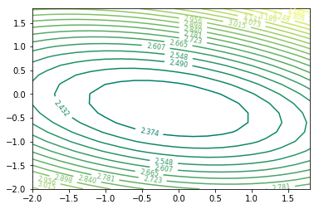
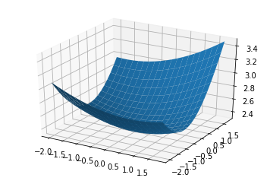
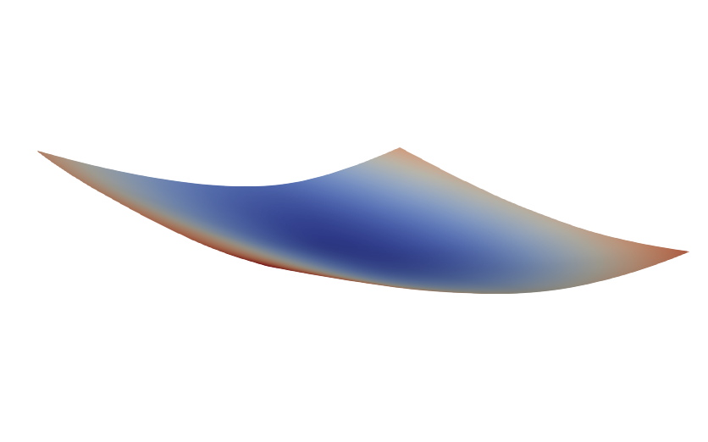
Without Regularization

Slide 9
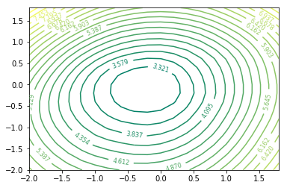
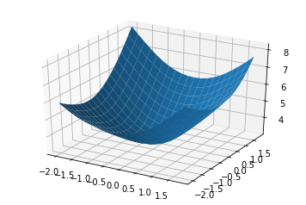
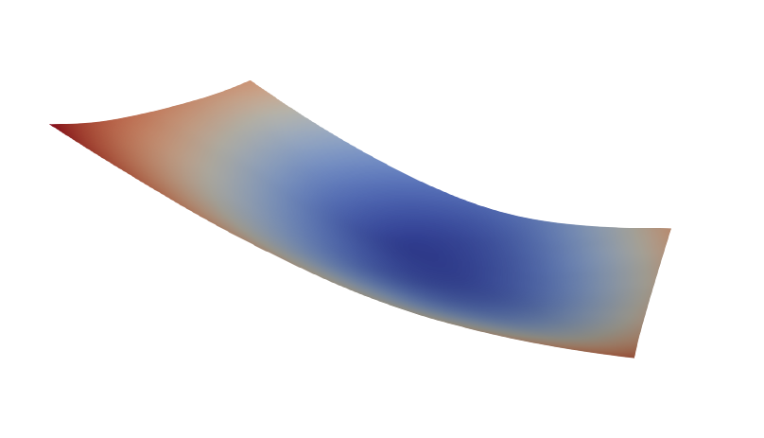
With L1 Regularization

Slide 10
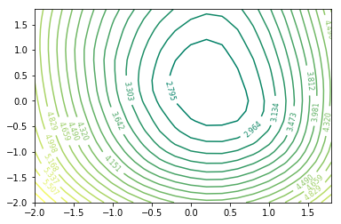
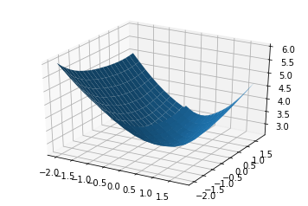
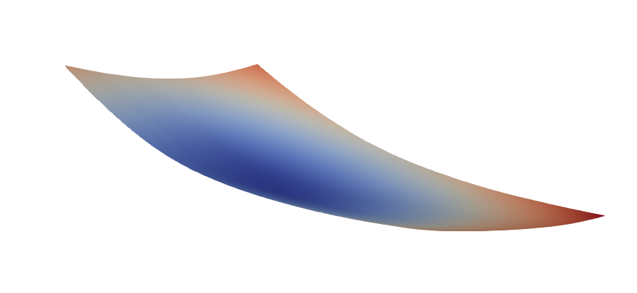
With L2 Regularization

Slide 11
Effect of depth on the loss landscape

Slide 12
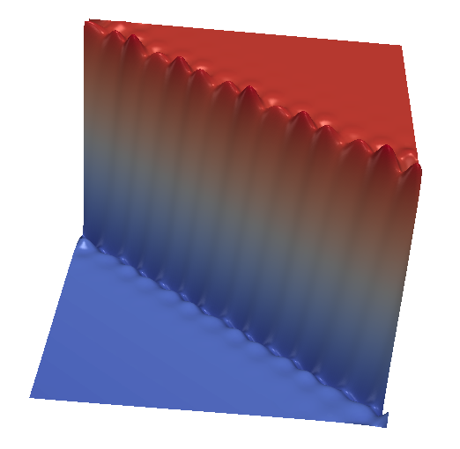
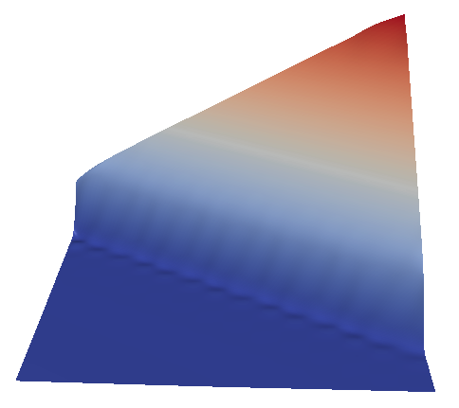
Shallow and deeper models
Seismic bumps dataset
1 layer with 1024 units
3 layers of 128, 64 and 32 units

Slide 13
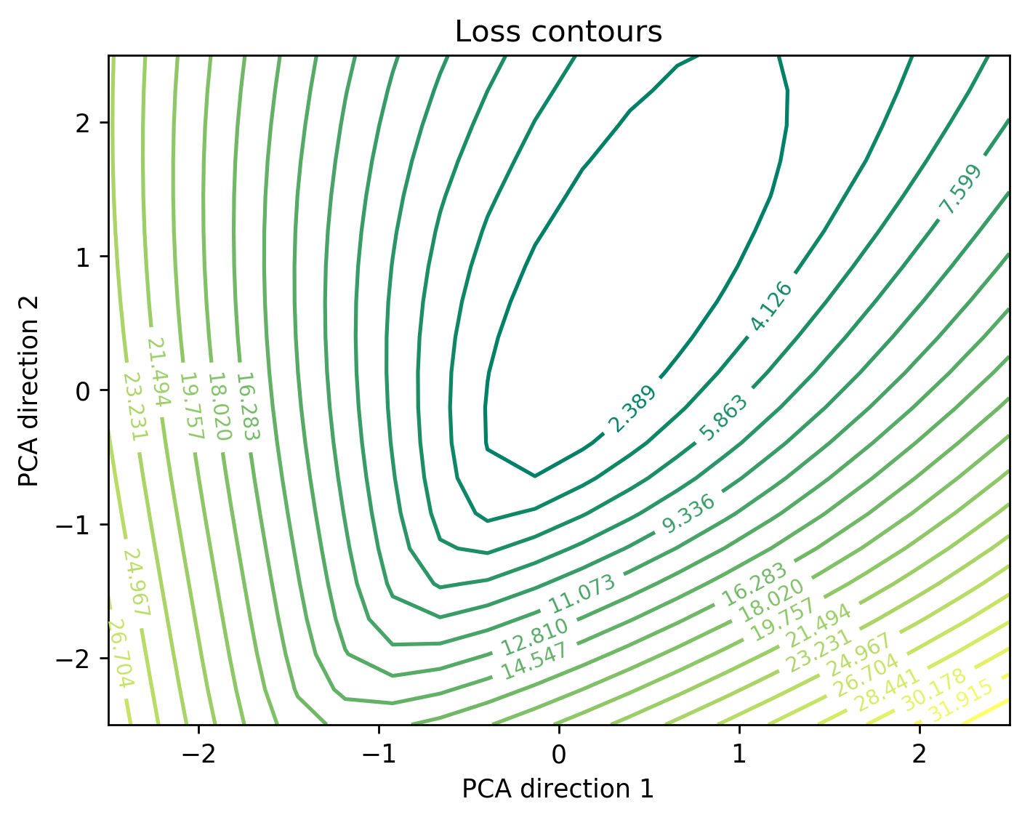
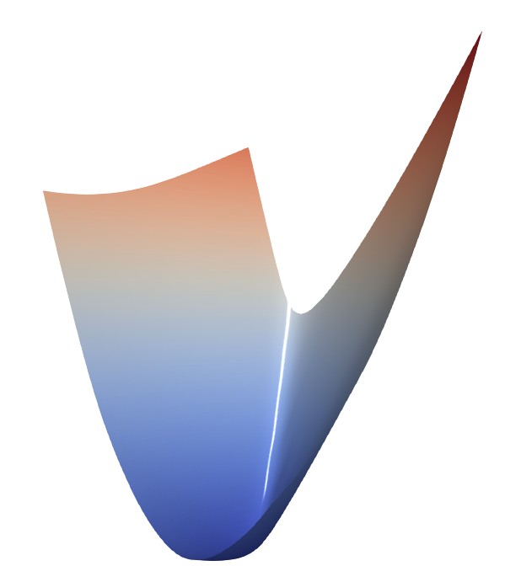
Shallow network – 4 layers

Slide 14
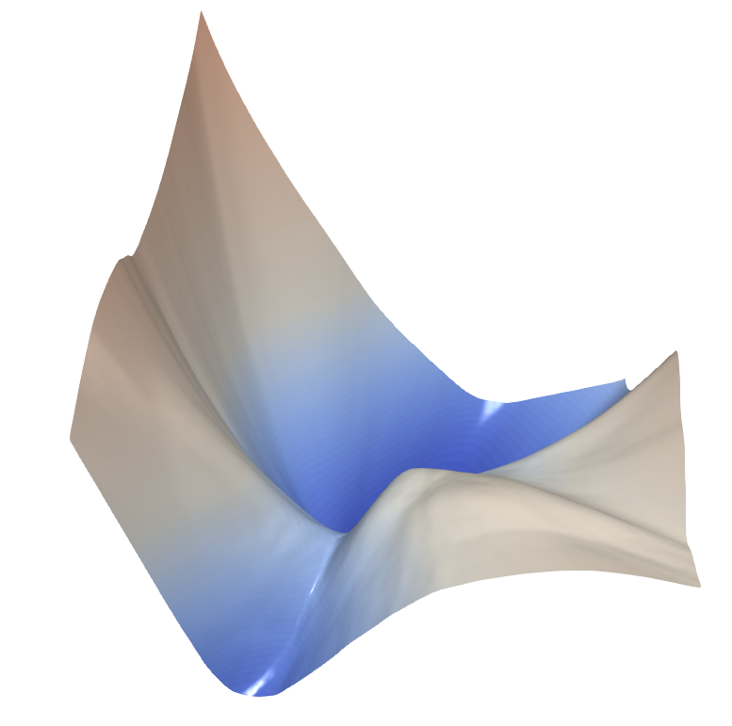
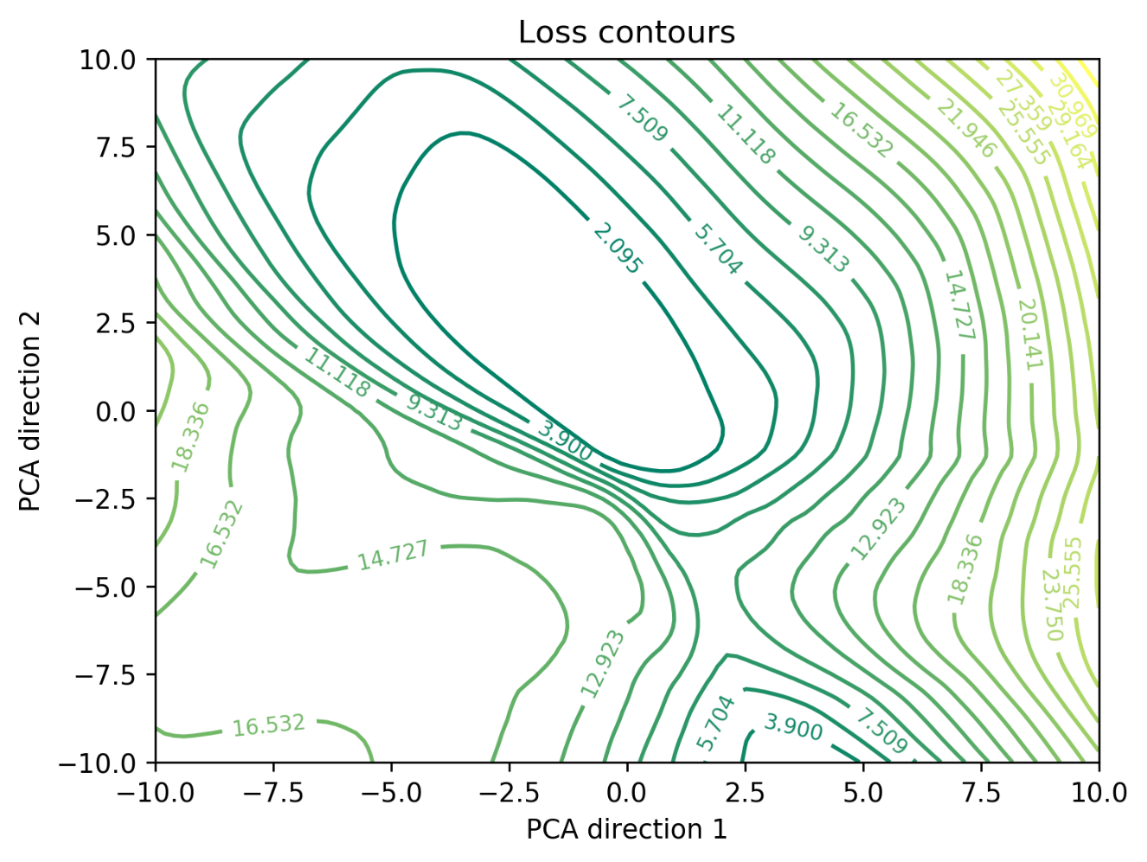
Deep Network – 16 layers

Slide 15
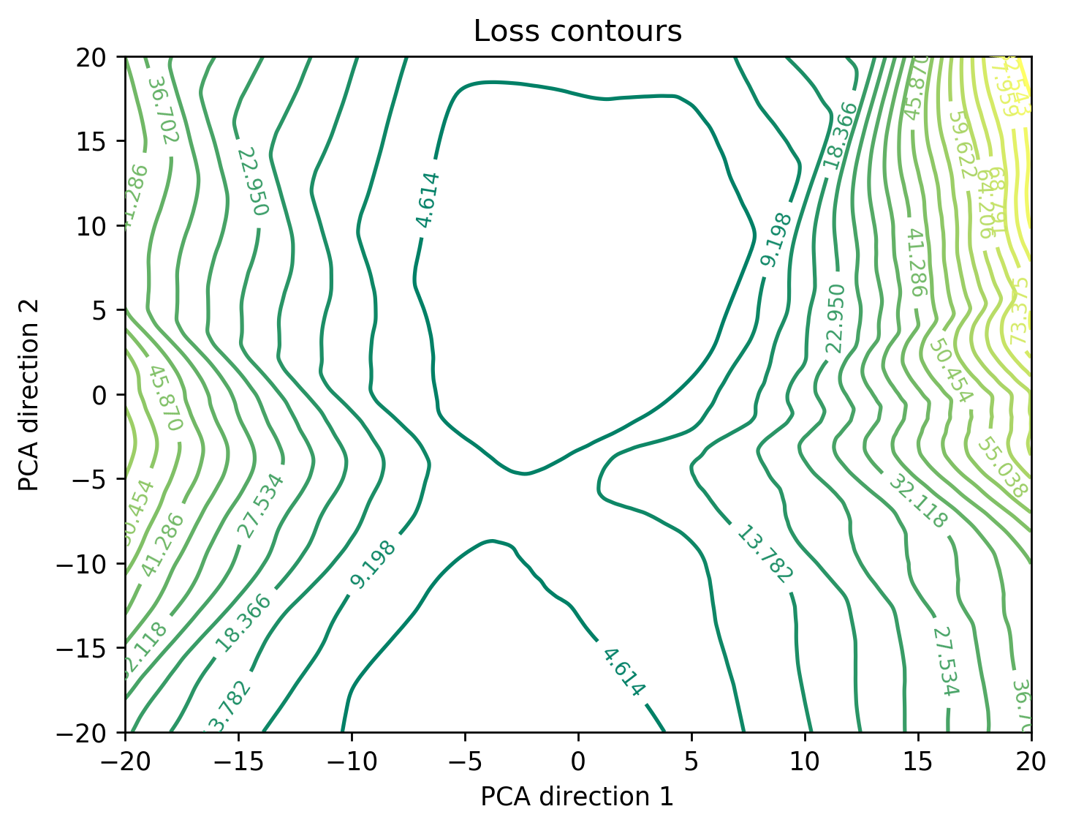
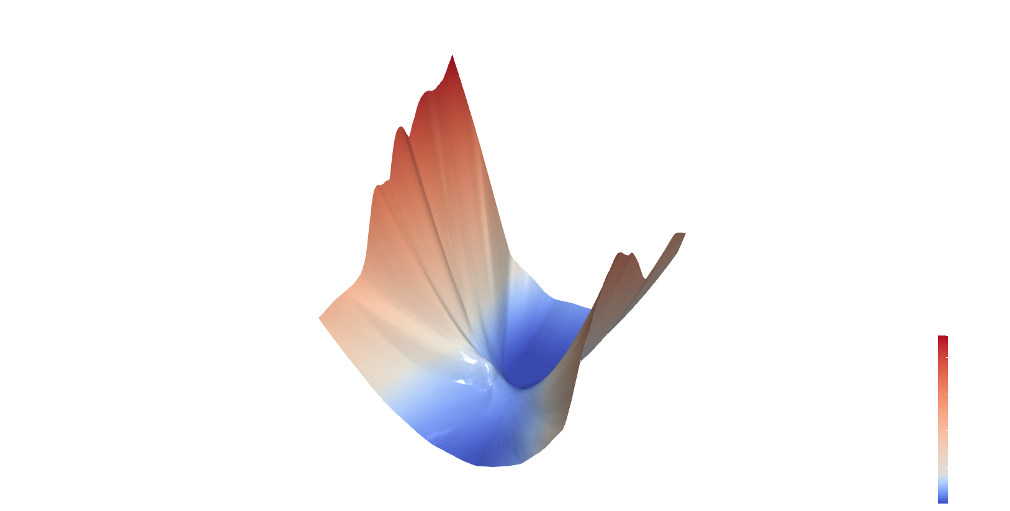
Deep Network – 16 layers

Slide 16
Effect of skip connections on the loss landscape

Slide 17
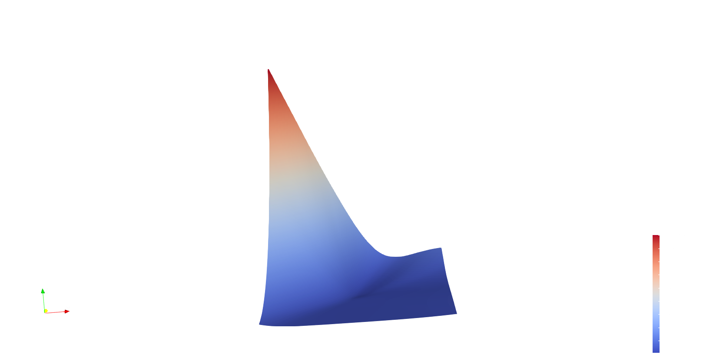


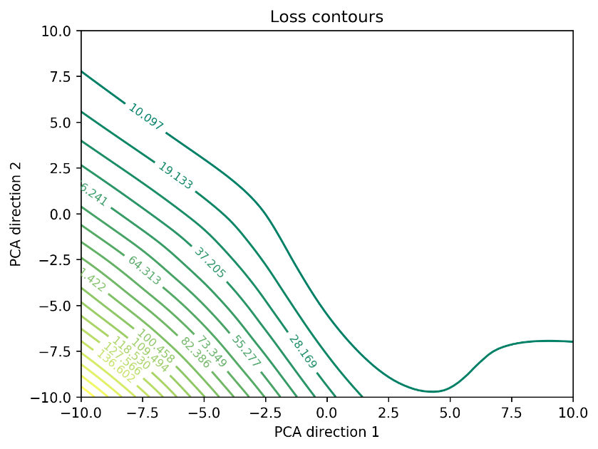
16 layer network with 1 skip connection

Slide 18
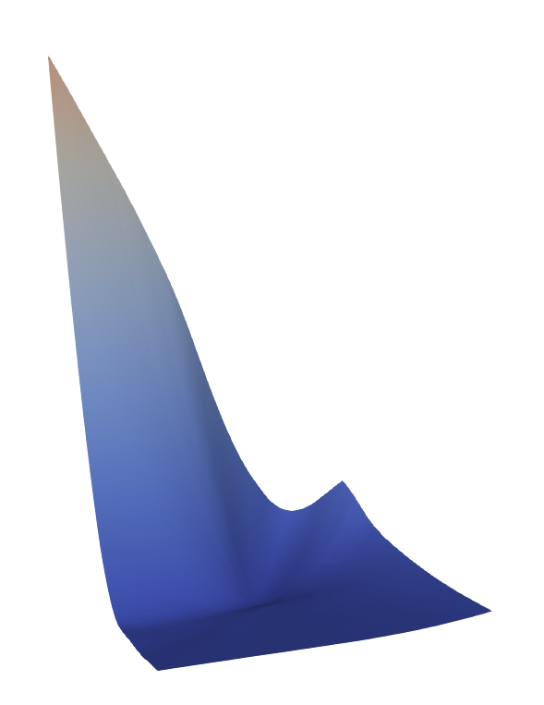

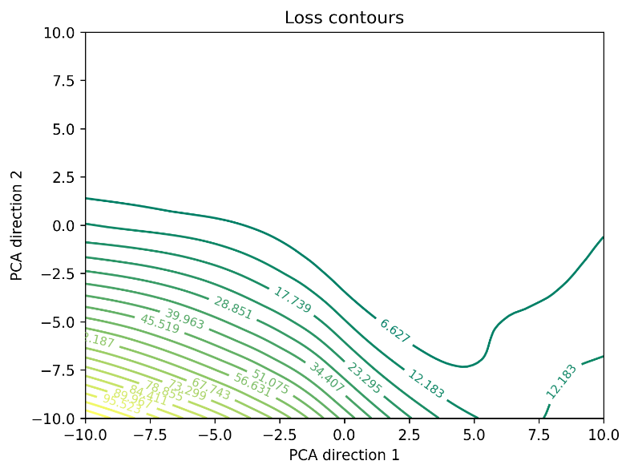
16 layer network with 1 skip connection

Slide 19
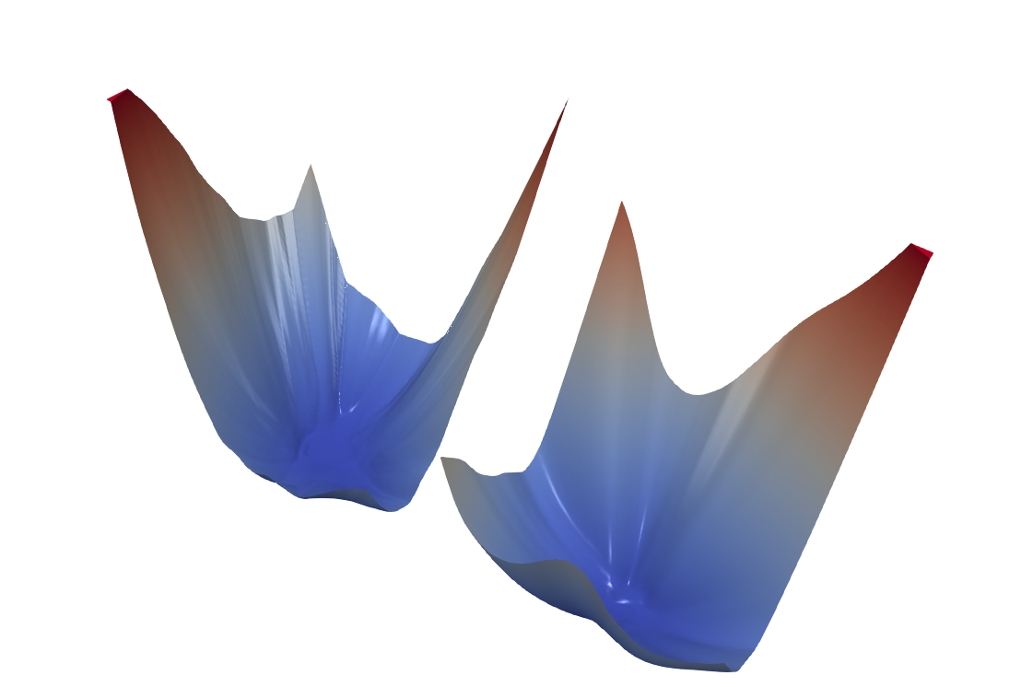
16 layer network with 1 skip connection
Without skip connection
With 1 skip connection
Random direction visualizations

Slide 20
Visualization of the Optimization trajectory

Slide 21
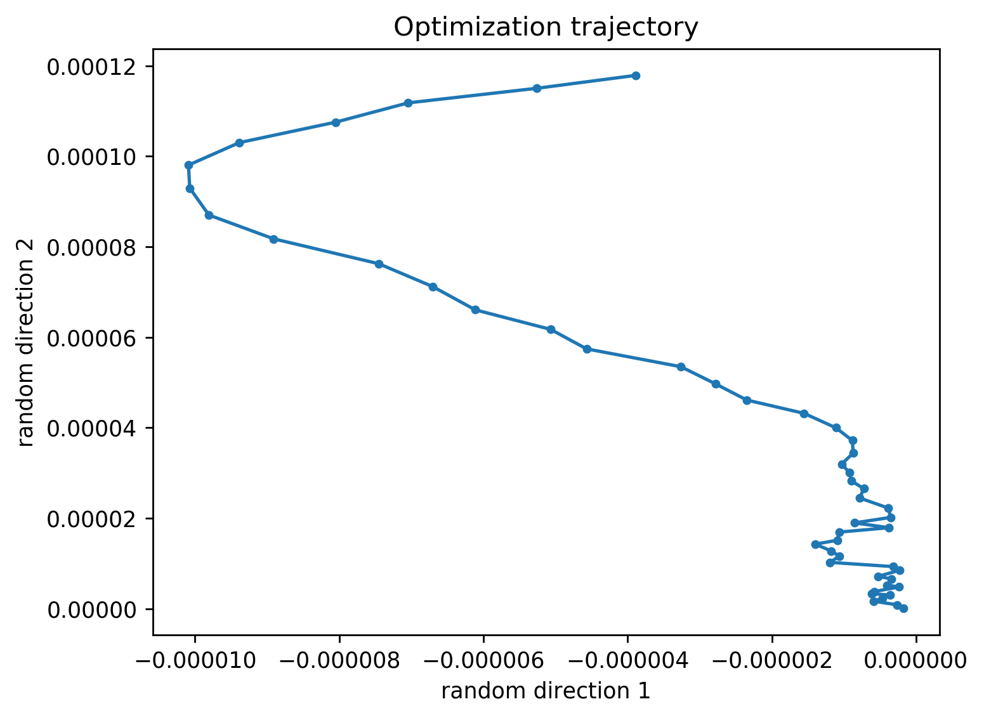
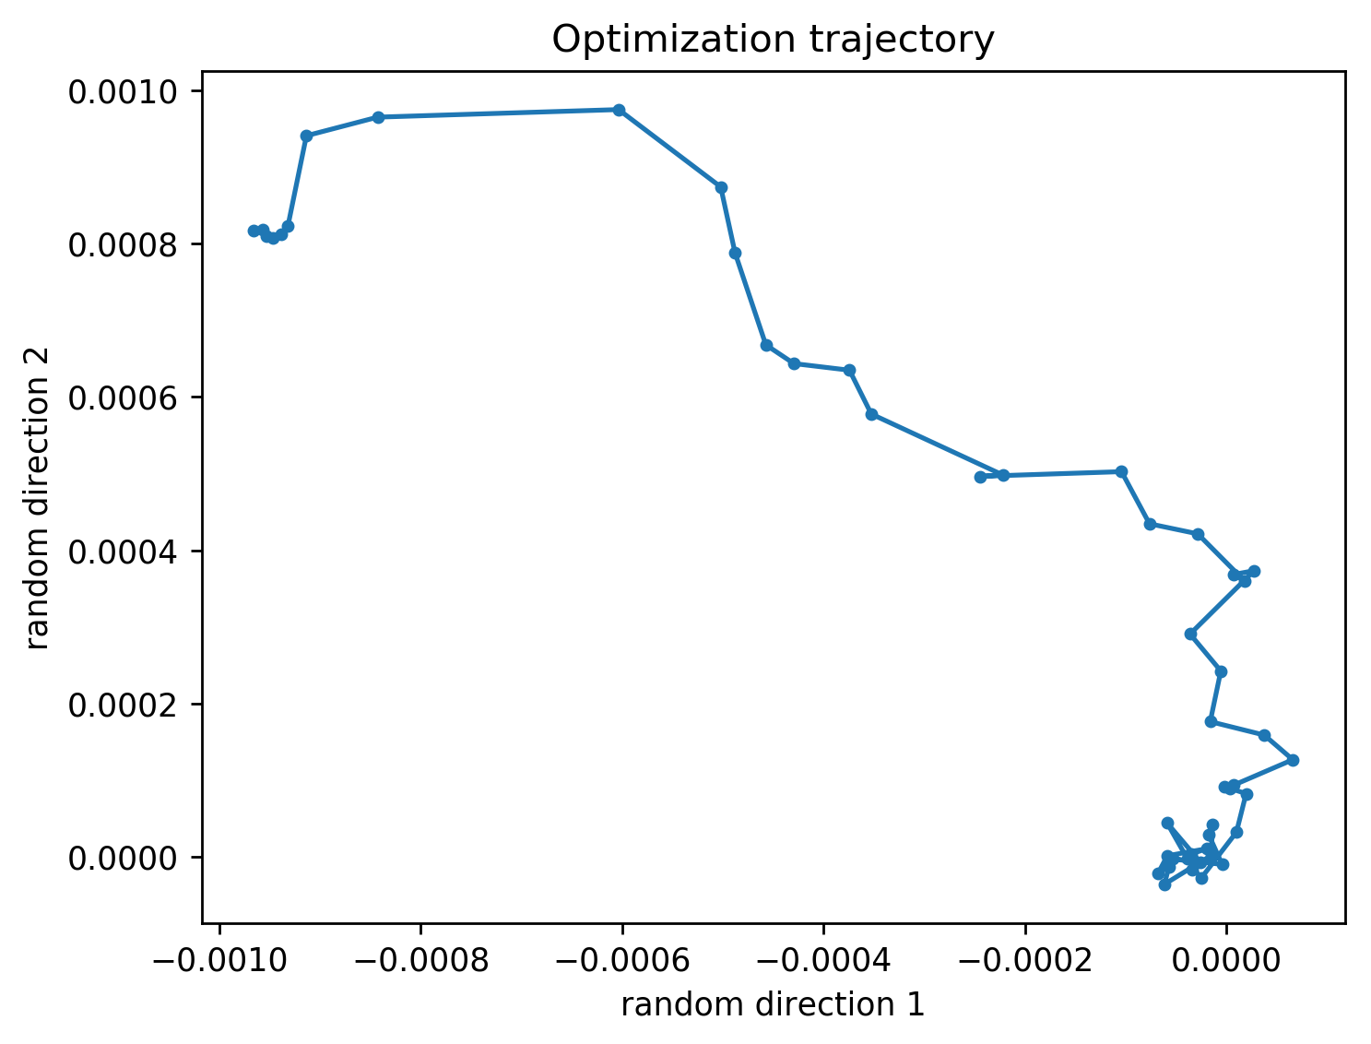
Random directions fail

Slide 22
Non Random Visualization
Define a direction matrix M which is a stack of difference directions
M = [W⁽⁰⁾-W^{(n)};W⁽¹⁾-W^{(n)};...;W^{(n-1)}-W^{(n)}]
Perform PCA on M and retain the first 2 principal components
Project each W^{(i)}-W^{(n)} onto the plane defined by the 2 principal components using least squares
Each projection is one point in the optimization trajectory

Slide 23
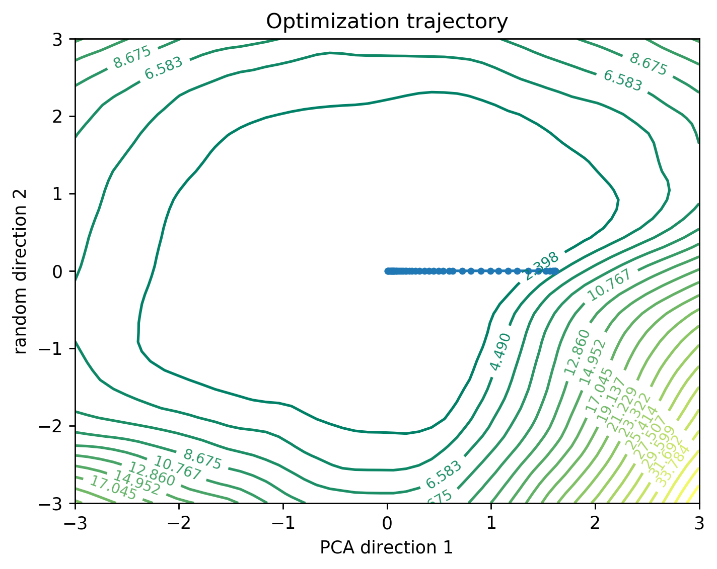
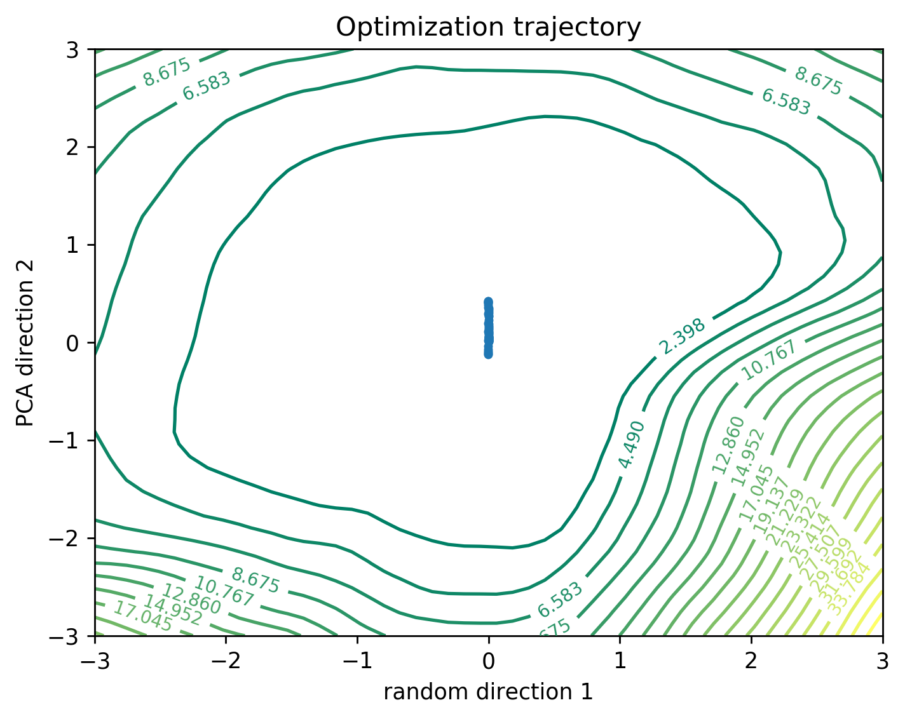
1 Random direction + 1 PCA direction

Slide 24
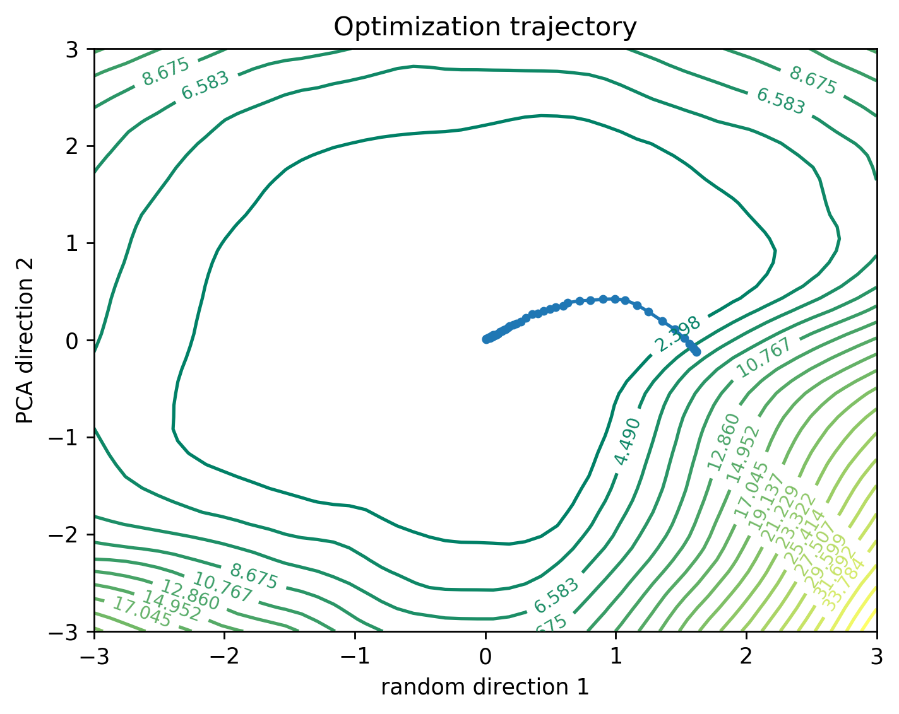
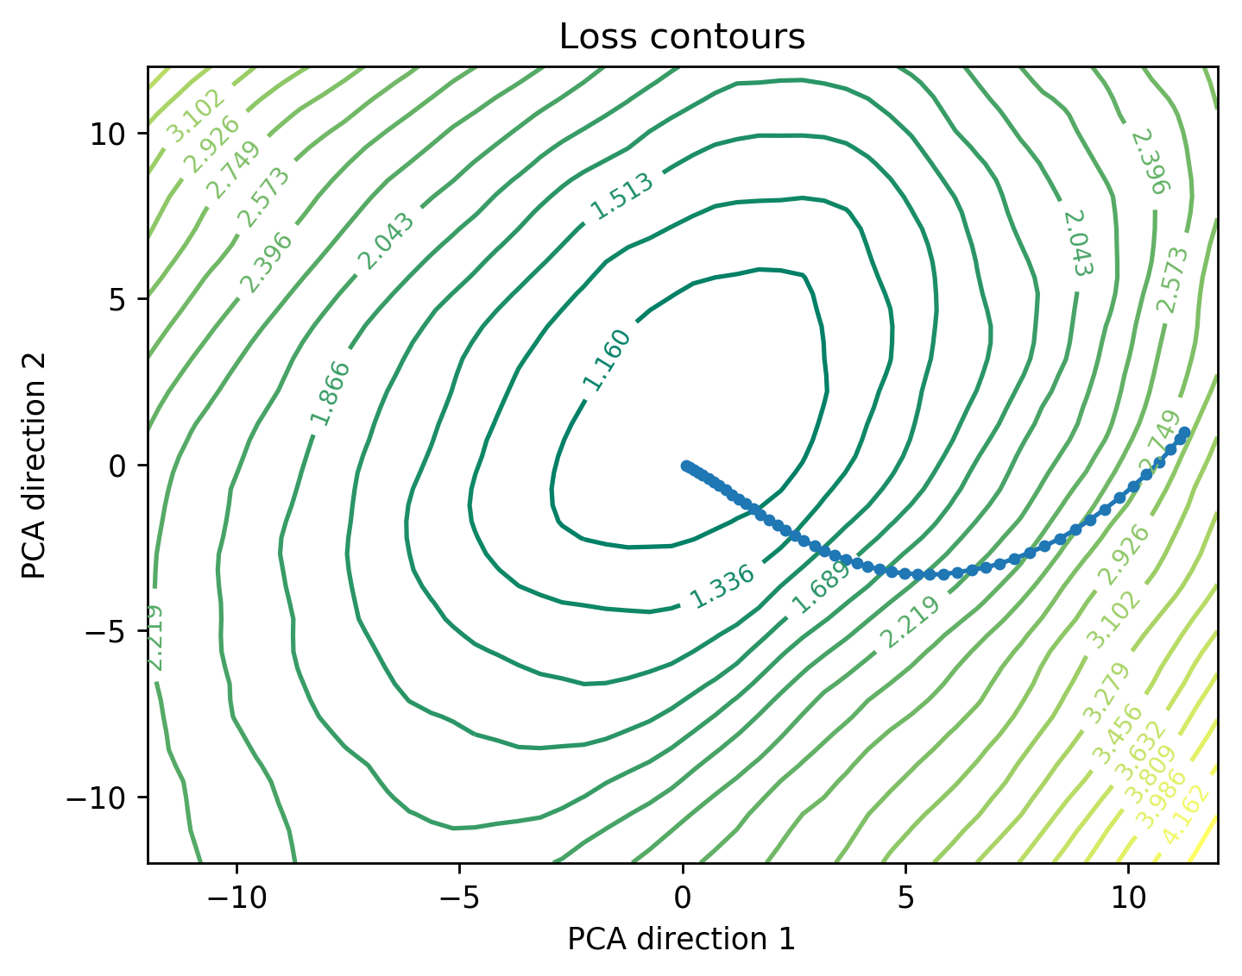
2 PCA directions

Slide 25
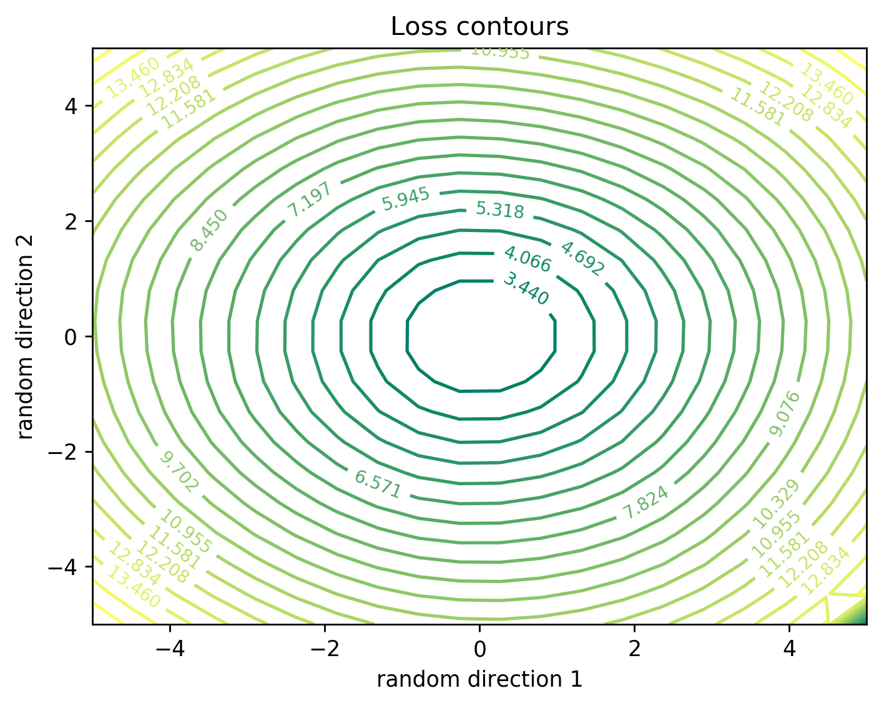

RNN loss landscape

Slide 26
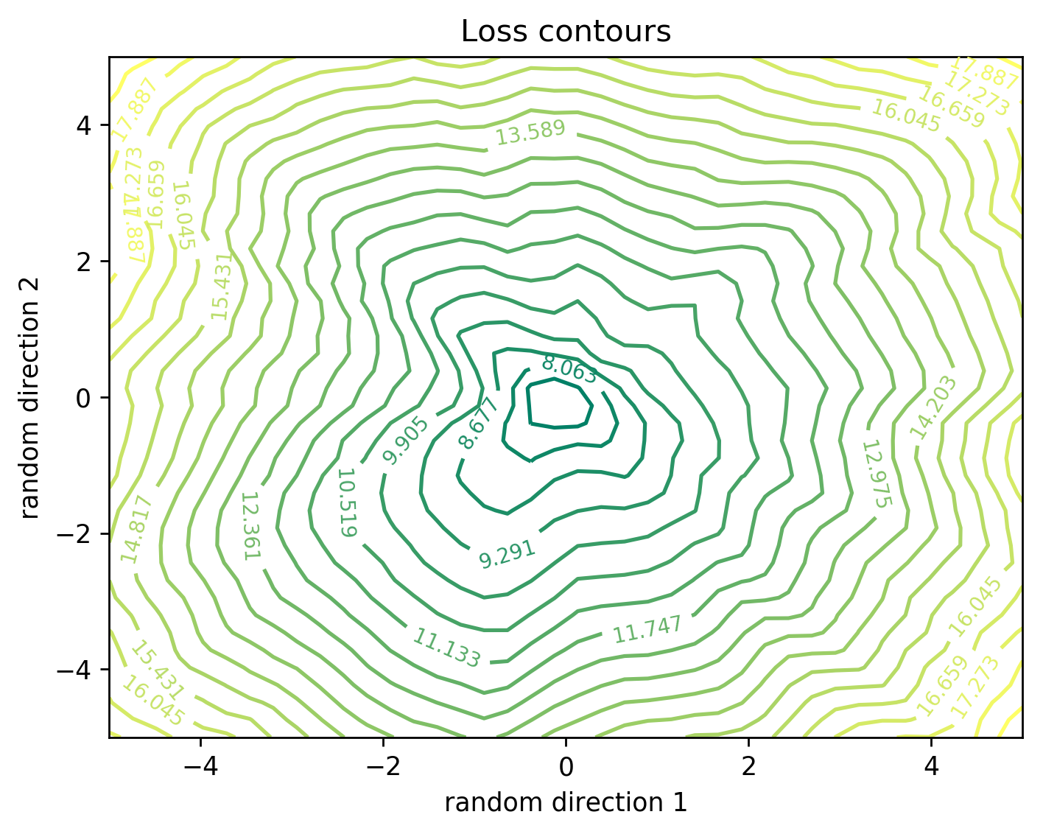
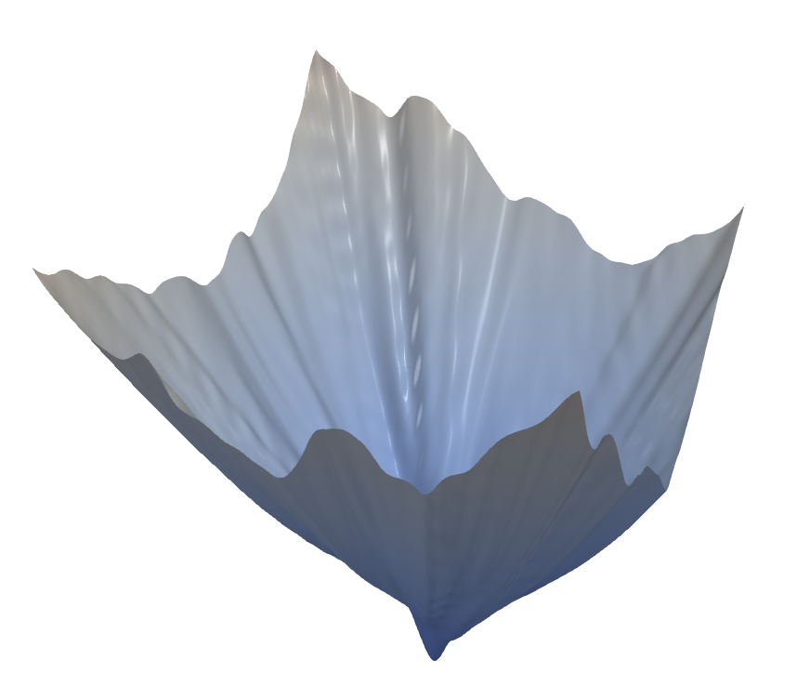
RNN loss landscape

Slide 27
Effect of Batch size on the loss landscape

Slide 28
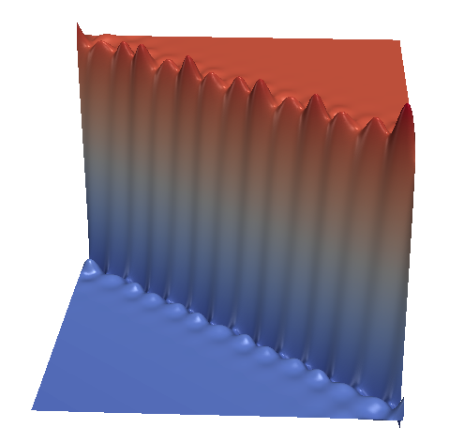
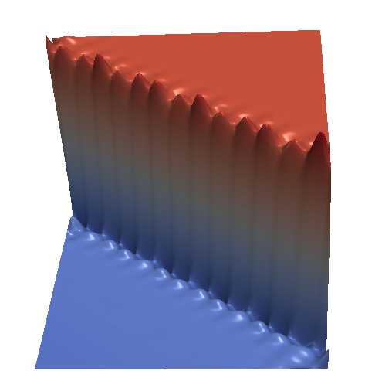
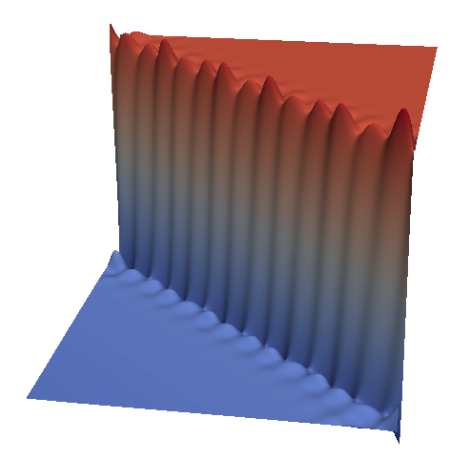
Smaller and larger batch size
shallow (1 layer) models
batch size 5
batch size 64
batch size 512

Slide 29
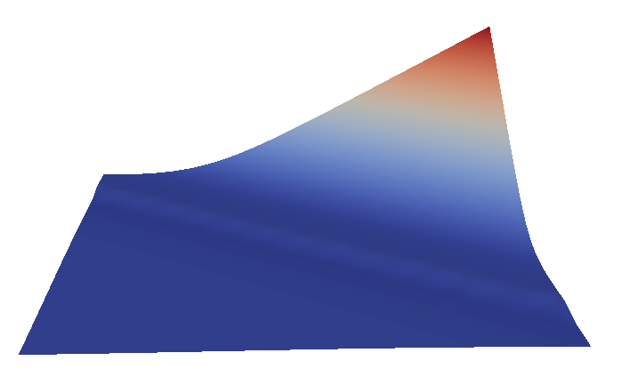
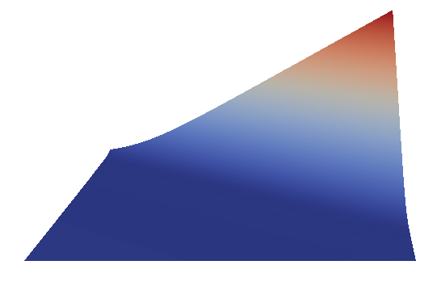
Smaller and larger batch size
“deep” (3 layers) models
batch size 5
batch size 64
batch size 512

Slide 30
Conclusion
Neural networks have advanced dramatically in recent years, largely on anecdotal knowledge and theoretical results with complex assumptions.
A more general understanding of the structure of neural networks is needed, which is why, we tried to provide insights into the consequences of a variety of choices facing the neural network practitioner, including network architecture, regularization, or batch size.
Effective visualization, when coupled with continued advances in theory, should help understanding how the choice of architecture and parameters can influence the optimization of neural networks.

Slide 31
Models Trained
S.No. | Architecture | Dataset | Reference
1 | CNN - 1 CONV layer | MNIST, CIFAR-10 | Slide 8,9,10,13
2 | CNN - 3 CONV layer | CIFAR-10 | Slide 23
3 | Feed forward - 16 layers | MNIST | Slide 14,15,23
4 | Feed forward - 16 layers, 1 skip connection from layer 2 to layer 14 | MNIST | Slide 17,18
5 | RNN - 1 layer sequence length = 30, hidden dimension = 120 | Shakespeare | Slide 25,26
6 | Feed forward - 1 layer | Seismic bumps | Slide 12,28,29
7 | Feed forward - 3 layers | Seismic bumps | Slide 12,28

Slide 32
References
[1] Paper Link: https://arxiv.org/pdf/1712.09913.pdf
[2] GitHub: https://github.com/tomgoldstein/loss-landscape
[3] ParaView: https://www.paraview.org/
[4] Visualization of learning in multilayer perceptron networks using principal component analysis. IEEE Transactions on Systems, Man, and Cybernetics.
[5] Theory of deep learning ii: Landscape of the empirical risk in deep learning. arXiv preprint arXiv:1703.09833, 2017.
[6] Seismic-bump dataset: https://archive.ics.uci.edu/ml/datasets/seismic-bumps

Slide 33
Thank you for your attention!

